Slide 1
BRITISH AIRWAYS
PREDICTING CUSTOMER BUYING BEHAVIOUR

Slide 2
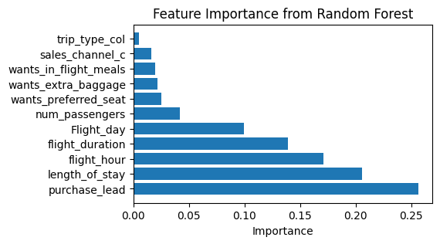
PREDICTIVE MODEL OUTCOME
RECALL
61%
In this scenario, missing a completed booking might have a significant impact, so we tried to minimize false negatives.
PRECISION
60%
With a precision of 60%, our model demonstrated a strong capability to accurately predict completed bookings, minimizing the occurrence of false positives.
With an accuracy of 63%, our model showcases a commendable level of correctness in predicting both completed and non-completed bookings.
ACCURACY
63%
Eleven key features emerged as crucial contributors, driving the accurate classification of booking completion in our model.

